Slide 1

Medgar Evers College
An Overview of the Operating Budget

Slide 2
Topic To Be Covered
An Overview of the MEC Operating Budget
What is a Budget?
What is a Tax Levy Budget?
What is a Non-Tax Levy Budget?
Why to Transfer Budget
What are the expenses categories in CUNYFirst?
The Purchasing Process
Independent Contractors Agreements
Modest Meals and Light Refreshments
Travel
Accounts Payment Process
Summary

Slide 3
MEC Budget Structure and Allocation Process
Tax Levy Funding Sources
CUNY provides an initial allocation of our annual budgets at the beginning of the academic year. Subsequent allocations are made during the year to adjust for revenue collections and to disburse additional funds. (State Aid – Tax Levy Funding)
The allocation starts with the base budget follows by the allocation of various lump sum appropriations. Additional allocations for College initiatives and other miscellaneous items are added throughout the year.
  Items that are paid for centrally, such as fringe benefits, energy, building rentals, and student financial aid, are not allocated to the colleges but expended centrally on their behalf.
  The colleges have the opportunity to generate additional operating funds by achieving savings from the energy budget. Savings remain with the campus; conversely, deficits must be funded within college budgets.

Slide 4
Budget Allocation Process, cont’d
Lump sum allocations: These include child care, collaborative programs with the NYC Dept. of Education, Coordinated Undergraduate Education, Language Immersion Programs, SEEK, ASAP and services for the disabled. Throughout the year, the colleges may receive additional allocations for various miscellaneous items. (City Support – Tax Levy)
    Programmatic Lump Sums
      The majority of these are determined by the Office of Academic Affairs and Office of Student Development and are based on existing or planned activities at the colleges.
Tuition Revenue Policy: The tuition revenue budget is appropriated by the State to the senior colleges. Because tuition revenue represents a component of the college's budget, it is critical that colleges collect revenue at or above their established targets. (Tuition & Fees – Paid by Students)

Slide 5
Non-Tax Levy Funding Source
Auxiliary Enterprises, Inc.: Funds generated by the corporation e.g. Parking Services, Bookstore, Food Service, etc.
MEC Educational Foundation: Tax deductible voluntary contributions, fund raising, and donations
MEC Student Faculty Association: Student Activity Fees
Research Foundation: State, City, Federal and Private Grants
Child Development Center: UPRE-K, Block Grant & Student Tuition and Fees

Slide 6
Tax Levy Funds
The Tax Levy funds are the primary operating budget of the college: Funds come from New York State Aid and tuition paid by students
Fiscal year 2017 operating budget is approximately $56 million (excluding fringe benefits, energy, rent and other expenses paid by CUNY Central Office)
All transactions must comply with city, state and CUNY guidelines

Slide 7
What is a Budget
A budget represents funds available to be spent
A budget is allocated at the beginning of each fiscal year can be modified between account or expense category
A budget is reduced each time salaries are paid and goods and/or services are purchase.

Slide 8
Budget Term
Allocated Budget: Funds available to be spent during the FY
Open Encumbrance:
  Pre-Encumbrance is a requisition entered in CF for goods and/or services that has not been processed by the Purchasing
  Encumbrances signifies that the requisition was processed and a purchase order was generated and issued to the vendors
  Expenditures: Payment was made to the vendor or employee
  Available Balance: Allocated Budget minus (Expenditures and Open Encumbrances)

Slide 9
Tax Levy Expenses Categories
PS – Regular (Full Time Faculty and Staff)
Teaching Adjuncts
Temp Services (College Assistant, Tutors and Administrative Adjuncts)
OTPS – Other Than Personnel Service

Slide 10
OTPS – CUNYFirst Categories
CUNYFIRST requires all OTPS transactions to be budgeted into one of the following six categories.
The categories are as follows:
  80120 Supplies & Materials
  80121 Travel
  80122 Contractual Services
  80123 Equipment Acquisition
  80124 Fringe Benefits (i.e. Honorariums, Merit Award)
  80125 Indirect Costs
Your purchase transaction will not be processed, if there is insufficient budget in the corresponding category creating a Budget Error.

Slide 11
Operating Timeline
July 1 – New Fiscal year begins
June 30 – Fiscal year ends
The fiscal year is identified by the June 30 end date

Slide 12
STEPS TO COMPLETE BEFORE PURCHASE
Before you begin your request to purchase as a Requestor, please follow the steps provided below:
Know your CUNYFIRST Department number.
Verify your balance by Checking Budget balances.
If the balance is insufficient or negative, please complete the Budget Transfer Form. Your request will not be processed, if the budget is not sufficient and in the proper account.
Complete the Budget Transfer form properly using your Department Name & Code as well as the Account Name & Code.
Determine the amount to transfer based on your current and anticipated need for the balance of the year.
Make sure the transfer amount (From & To) is balanced and equal zero.
Email the completed form to: BudgetOffice@mec.cuny.edu
Once the budget transfer is made, you will be notified.

Slide 13
Security Authorization
(CUNYfirst eProcurement, Travel Expenses, Authorization Forms – NTL)
Departments can authorize individuals to submit various transactions, request transfers, and receive budget reports
Necessary for audit purposes
Must be validated each fiscal year
May be updated throughout the fiscal year by request
If not completed, a number of transactions will be restricted, including budget transfers and purchase requisitions

Slide 14
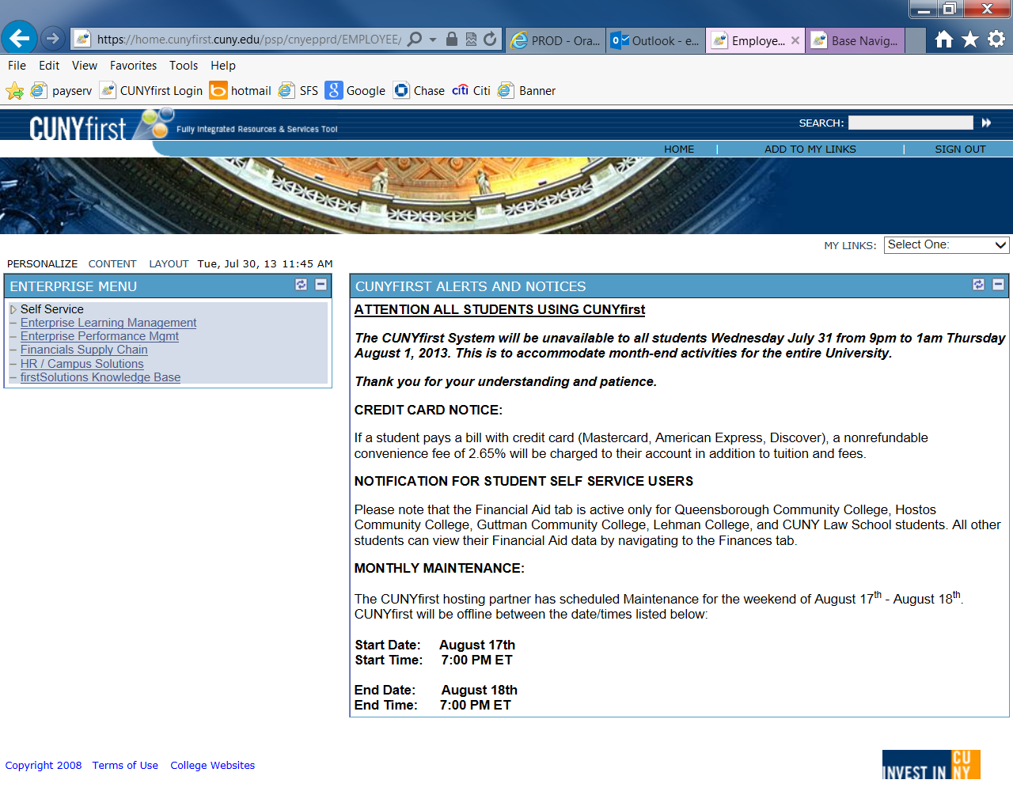
Checking Budget Balances – Query Viewer
Click “Financials Supply Chain

Slide 15
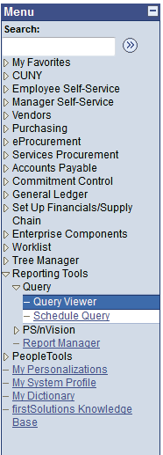
Checking Budget Balances – Query Viewer
To view the available budget balance for each account code for your
department, you must take the following steps:
1. Click on ‘Reporting Tools’
2. Click on ‘Query’
3. Click on ‘Query Viewer’

Slide 16
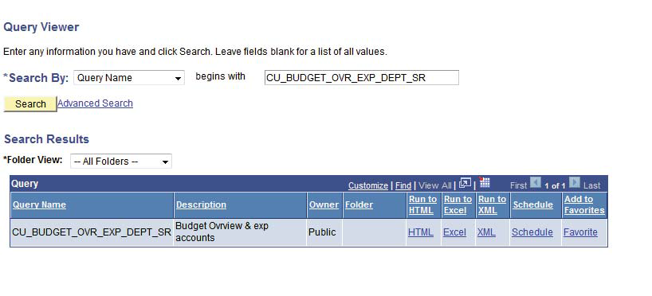
Checking Budget Balances – Query Viewer
4. Type in the Query Name below:
CU_BUDGET_OVR_EXP_DEPT_SR
5. Click ‘Search’

Slide 17
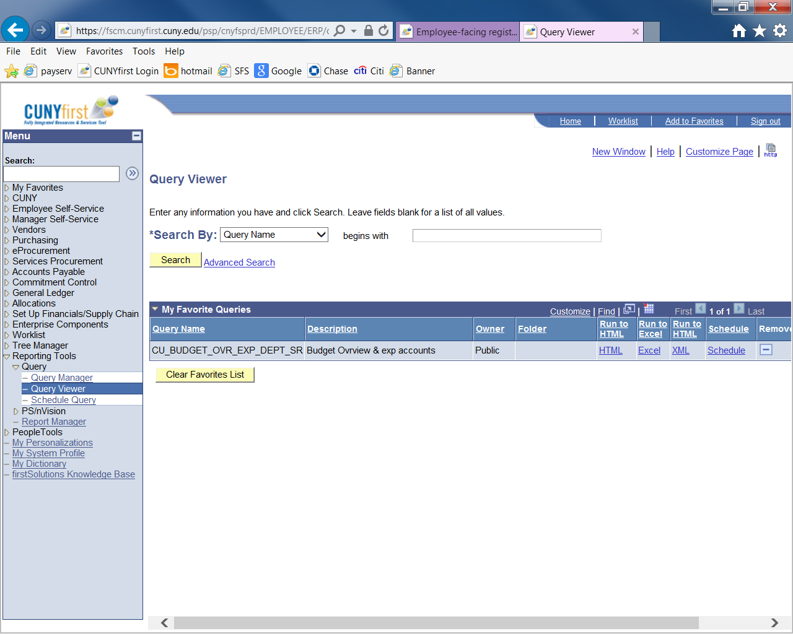
Checking Budget Balances – Query Viewer
Click “Add to Favorite” to save the step of typing the query name

Slide 18
Checking Budget Balances – Query Viewer
6. Click on the blue underlined link or export the file into
HTML for filtering.

Slide 19
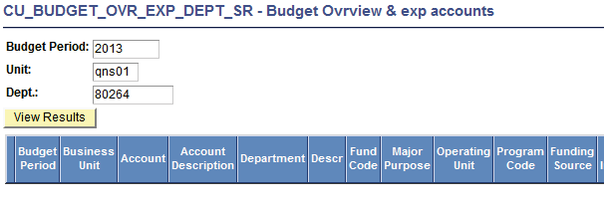
Checking Budget Balances – Query Viewer
7. For Budget Period, type in the four-digit fiscal year (ex. 2018)
8. For Unit, Type in MEC01
9. For “Dept”, type in your 5-digit CUNYFIRST Department Code
10. Click View Results
2018
MEC01
12345

Slide 20
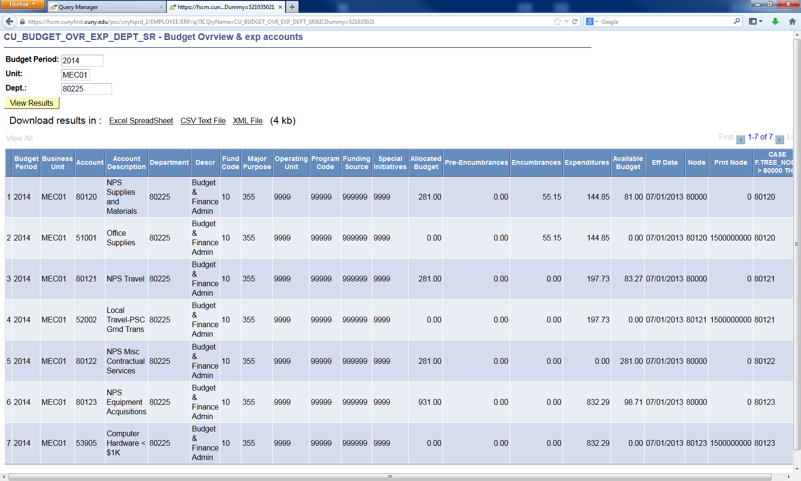
Checking Budget Balances – Query Viewer
Download results in Excel Spreadsheet if needed.

Slide 21
Checking Budget Balances – Query Viewer
Refer to the Allocated Budget column to assess how much has been budgeted to each account code and refer to the Available Budget column to review your available budget balance in each account code. This available budget for OTPS is determined by adding this OTPS Account Codes 80120-80125 only.
There maybe PS Regular, PS Temp & Adjunct Rows that appear with this query. Please delete these rows to determine your OTPS balance.
In addition, if there are any other accounts that appear other than 80120-80125 in the Account Column, delete them as well.

Slide 22
SharePoint Reports
On the college website under Faculty & Staff
Click on SharePoint Portal 2013
Log on with your User Name and Password
Click on the Budget office link
Select your division
Select your department and navigation the system.

Slide 23
Tax Levy Budget Transfers
Funds may be transferred between departments and expense categories
Transfers may be requested via emails
Transfers can only be requested by an authorized signatory
Transfers requested by an unauthorized signatory with be disallowed.

Slide 24
Budget Transfer Form
FISCAL YEAR 2017-2018 TAX-LEVY BUDGET TRANSFER FORM
DATE: _______________________________________
FROM |  |  |  |  |  |  | TO
Department Name: | _____________________________________________ |  |  |  |  |  | Department Name: | _____________________________________________
Department Number: | _____________________________________________ |  |  |  |  |  | Department Number: | _____________________________________________
OTPS Account Code | Amount |  |  |  |  |  | OTPS Account Code | Amount
80120 | _____________________ |  | Supplies & Materials |  |  |  | 80120 | _____________________ |  | Supplies & Materials
80121 | _____________________ |  | Travel |  |  |  | 80121 | _____________________ |  | Travel
80122 | _____________________ |  | Misc. Contractual Services |  |  |  | 80122 | _____________________ |  | Misc. Contractual Services
80123 | _____________________ |  | Equipment Acquisitions |  |  |  | 80123 | _____________________ |  | Equipment Acquisitions
80124 | _____________________ |  | Fringe Benefits |  |  |  | 80124 | _____________________ |  | Fringe Benefits
TOTAL | _____________________ |  |  |  |  |  | TOTAL | _____________________
Explanation: | ___________________________________________________________________________________________________________________
 | ___________________________________________________________________________________________________________________
 | ___________________________________________________________________________________________________________________
Authorized Signature: | _________________________________________________ |  |  |  |  |  | Date: __________________________________
NOTE: After completion of this form, please email it to the Budget Office at BudgetOffice@mec.cuny.edu.

Slide 25
Budget Call

Slide 26
MEC Budget Call Process
Budget Call Letter is sent to Vice Presidents, Deans, Department Chairs/Managers
Three years of historical data, Current Year OTPS (other than
personnel services) P.S. Full-time report, Submission Template and
Supplemental Information.
Completed budget requested submitted by dept. Chairs/Managers to area Vice President/Deans for review and approval
Completed budget request submitted by Co-chairs for MEC’s 25% initiatives
The completed budget request must be submitted by area Vice Presidents/Deans to the Budget Office by the April due date.
Completed budget requests are submitted by Chairs/Managers to area Vice Presidents/Deans for review and discussion.

Slide 27
MEC - Budget Call Process – continued.
Budget review and recommendations made in consultation with the President.
After President’s approval written notification will be sent by the Budget Office to Vice Presidents, Deans Dept. Chairs/Managers, notifying them of their approved Budget allocation.
Budget Allocations are subject to adjustment based on the College’s actual budget allocation and tuition revenue collections.

Slide 28
OTPS - CUNYFIRST
Requisition Submission into CUNYFirst
  Budget Error
    Categories – Supplies, Contracts, Travel, & Equipment
    Contact the budget office
Receipts
Travel and Expenses
Meal and Light Refreshments
CUNYFirst Training

Slide 29
Take Away Action
Understanding the budget processes
Attending training sessions and reading email announcements
Managing transfers and purchases effectively
Review your budget reports in CF and Sharepoint to monitor your activities
Utilize the Budget and Finance Departments and its resources for planning and decision making
Remember if you fail to plan, you plan to fail.

Slide 30
Q & A

