Slide 1
CUNYFIRST OTPS BUDGET ACCOUNT CATEGORIES
CUNYFIRST requires all OTPS transactions to be budgeted in one of the 6 corresponding categories.
The categories are as follows:
80120 Supplies & Materials
80121 Travel
80122 Contractual Services
80123 Equipment Acquisition
80124 Fringe Benefits (i.e. Honorariums, Merit Award)
80125 Indirect Costs
Your purchase transaction will not be processed, unless there is sufficient budget allocation in the corresponding category.
CUNYFIRST does not have pool budgeting.

Slide 2
STEPS TO COMPLETE BEFORE PURCHASE
Before you begin your request to purchase as a Requestor, please follow the steps provided below:
Know your CUNYFIRST Department number.
Verify your balance by Checking Budget balances.
If the balance is insufficient or negative, please complete the CUNYFIRST OTPS Budget Transfer Form provided. Your request will not be processed unless there is sufficient budget in the proper account.
Complete the Budget Transfer form properly using your Department Name & Code as well as the Account Name & Code.
Determine the amount to transfer based on your current needs and any anticipated needs for the balance of the year.
Make sure the transfer amount (From & To) is balanced as it must equal zero.
Email the completed form to: BudgetOffice@mec.cuny.edu
Once the budget transfer is made, you will be notified.

Slide 3
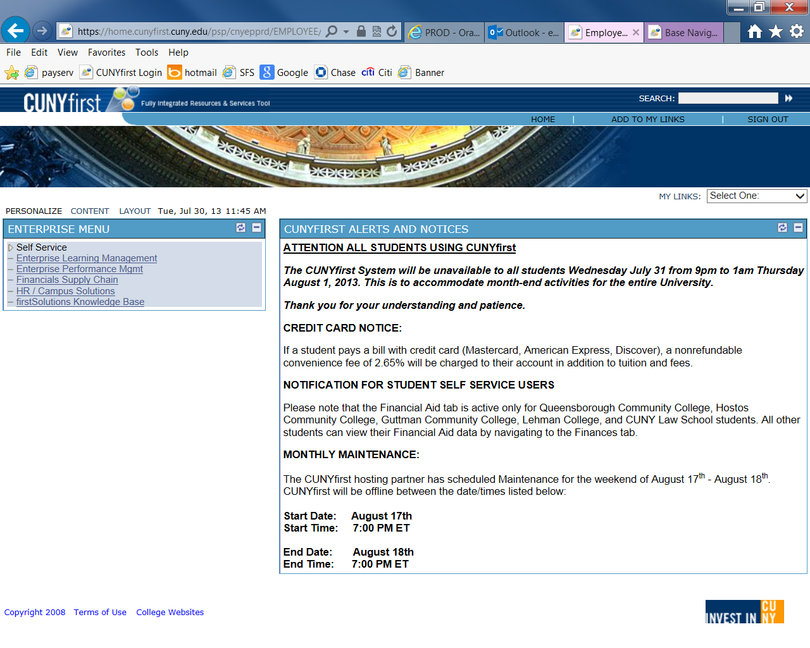
Checking Budget Balances – Query Viewer
Click “Financials Supply Chain”

Slide 4
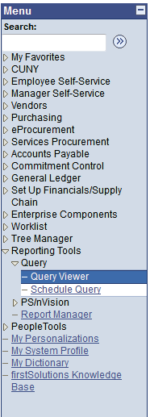
Checking Budget Balances – Query Viewer
To view the available budget balance for each account code for your
department, you must take the following steps:
1. Click on ‘Reporting Tools’
2. Click on ‘Query’
3. Click on ‘Query Viewer’

Slide 5
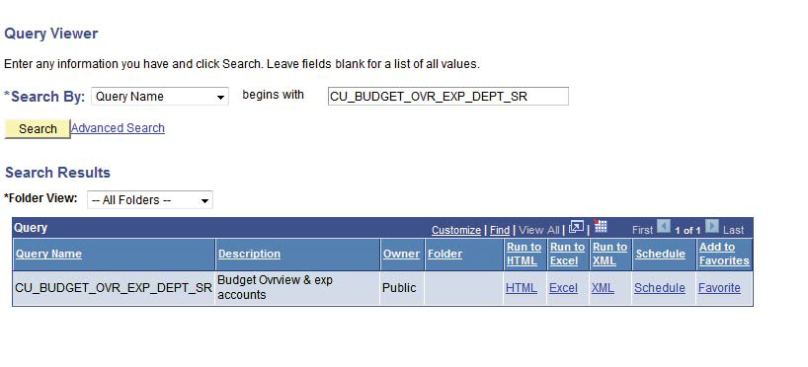
Checking Budget Balances – Query Viewer
4. Type in the Query Name below:
CU_BUDGET_OVR_EXP_DEPT_SR
5. Click ‘Search’

Slide 6
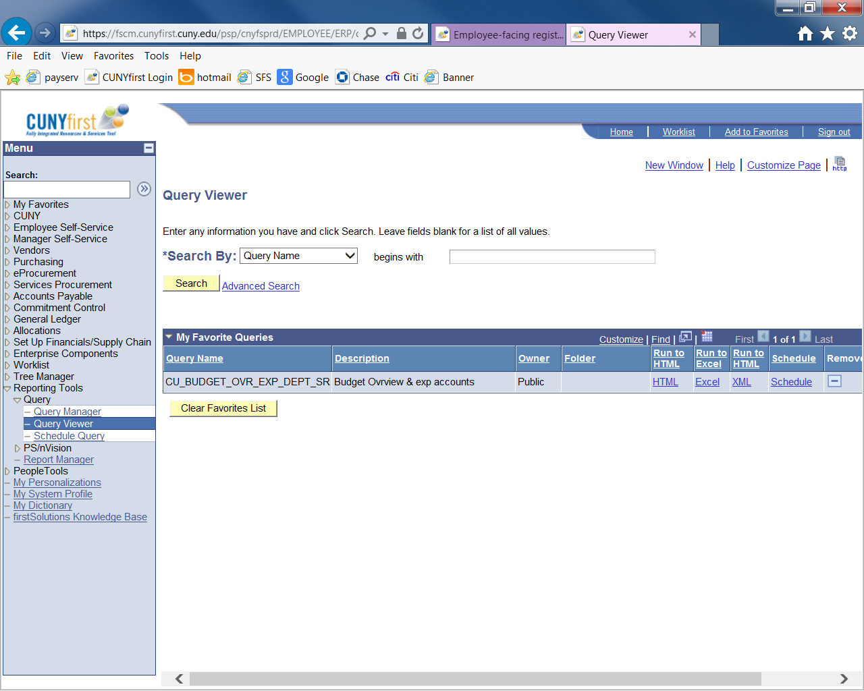
Checking Budget Balances – Query Viewer
Click “Add to Favorite” to save the step of typing the query name

Slide 7
Checking Budget Balances – Query Viewer
6. Click on the blue underlined link or export the file into
HTML for filtering.

Slide 8
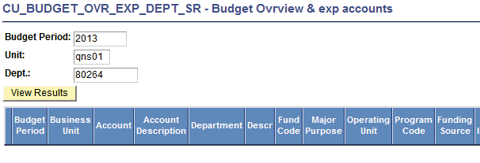
Checking Budget Balances – Query Viewer
7. For Budget Period, type in the four-digit fiscal year (ex. 2016)
8. For Unit, Type in MEC01
9. For “Dept”, type in your 5-digit CUNYFIRST Department Code
10. Click View Results
2016
MEC01
12345

Slide 9
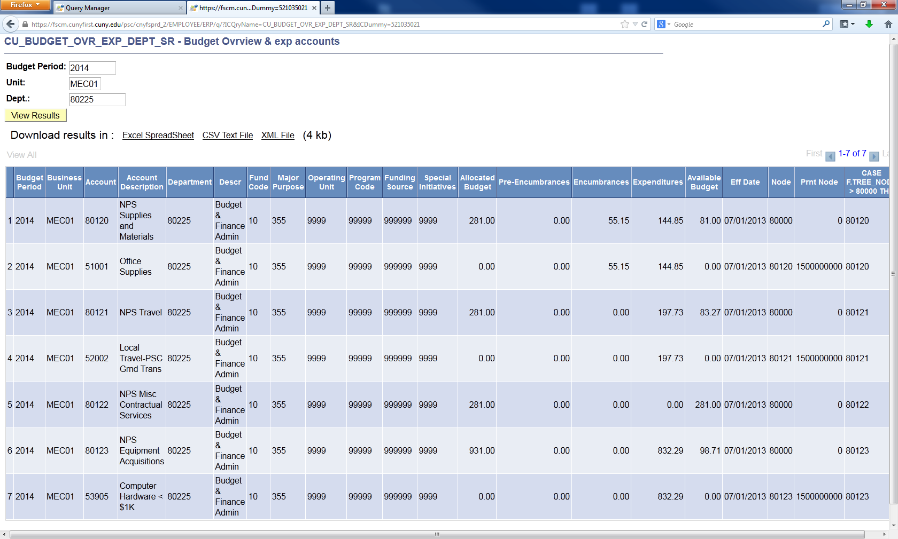
Checking Budget Balances – Query Viewer
Download results in Excel Spreadsheet if needed.

Slide 10
Checking Budget Balances – Query Viewer
Refer to the Allocated Budget column to assess how much has been budgeted to each account code and refer to the Available Budget column to review your available budget balance in each account code. This available budget for OTPS is determined by adding this OTPS Account Codes 80120-80125 only.
There maybe PS Regular, PS Temp & Adjunct Rows that appear with this query. Please delete these rows to determine your OTPS balance.
In addition, if there are any other accounts that appear other than 80120-80125 in the Account Column, delete them as well.

Slide 11
Budget Transfer Form
FISCAL YEAR 2017-2018 TAX-LEVY BUDGET TRANSFER FORM
DATE: _______________________________________
FROM |  |  |  |  |  |  | TO
Department Name: | _____________________________________________ |  |  |  |  |  | Department Name: | _____________________________________________
Department Number: | _____________________________________________ |  |  |  |  |  | Department Number: | _____________________________________________
OTPS Account Code | Amount |  |  |  |  |  | OTPS Account Code | Amount
80120 | _____________________ |  | Supplies & Materials |  |  |  | 80120 | _____________________ |  | Supplies & Materials
80121 | _____________________ |  | Travel |  |  |  | 80121 | _____________________ |  | Travel
80122 | _____________________ |  | Misc. Contractual Services |  |  |  | 80122 | _____________________ |  | Misc. Contractual Services
80123 | _____________________ |  | Equipment Acquisitions |  |  |  | 80123 | _____________________ |  | Equipment Acquisitions
80124 | _____________________ |  | Fringe Benefits |  |  |  | 80124 | _____________________ |  | Fringe Benefits
TOTAL | _____________________ |  |  |  |  |  | TOTAL | _____________________
Explanation: | ___________________________________________________________________________________________________________________
 | ___________________________________________________________________________________________________________________
 | ___________________________________________________________________________________________________________________
Authorized Signature: | _________________________________________________ |  |  |  |  |  | Date: __________________________________
NOTE: After completion of this form, please email it to the Budget Office at BudgetOffice@mec.cuny.edu.

